Slide 1

Health Insurance 101
Updated: October 2024

Slide 2




We will DISCUSS
NJ FamilyCare
Open Enrollment
New Jersey Marketplace
Choosing an Insurance Plan

Slide 3
NJ FamilyCare

Slide 4

NJ FamilyCare (Medicaid)
NJ FamilyCare provides children and adults under age 65 with free health insurance.
This includes doctor visits, prescriptions, lab tests, x-rays, hospitalization, vision and dental care, and mental health services.
Children under 19 can qualify for NJ FamilyCare regardless of their immigration status. Pregnant women who are lawfully present can qualify, regardless of the date that they entered the United States.

Slide 5
NJ FamilyCare (Medicaid)
If you are eligible, you can apply at any time of the year.
Income is calculated based on your Modified Adjusted Gross Income (MAGI).
Adjusted Gross Income (AGI)
Non-taxable Social Security Benefits
Tax Exempt Interest
Excluded Foreign Income
  As defined by the IRS, AGI is gross income minus adjustments to income.
  Line 11
  IRS Form 1040
  Social Security benefits not included in gross income.
  Line 6a minus Line 6b
  IRS Form 1040
  Interest income that is not subject to federal income tax.
  Line 2a
  IRS Form 1040
  Foreign earned income excluded from taxation of individuals who live abroad.
  IRS Form 2555
Modified Adjusted Gross Income (MAGI)

Slide 6
NJ FamilyCare (Medicaid)
Adults aged 19-64 with income up to 138% FPL. Private insurance is allowed; NJ FamilyCare will be secondary.
  $2,351/month for a couple
Pregnant people with income up to 205% FPL
  $4,411/month for pregnant person who is married expecting her first child
Children under 19 are eligible with higher incomes up to 355% of the Federal Poverty Level (FPL).
  $9,230/month for a family of four

Slide 7
NJ FamilyCare (Medicaid)

Slide 8
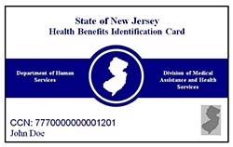

NJ FamilyCare (Medicaid)
Recipients will receive two cards.
The first is for “Fee for Services” Medicaid.
Recipients choose a Managed Care Organization/HMO to provide health services. Enrollment is typically within 30-60 days after initial NJ FamilyCare enrollment.
  5 Options:

Slide 9
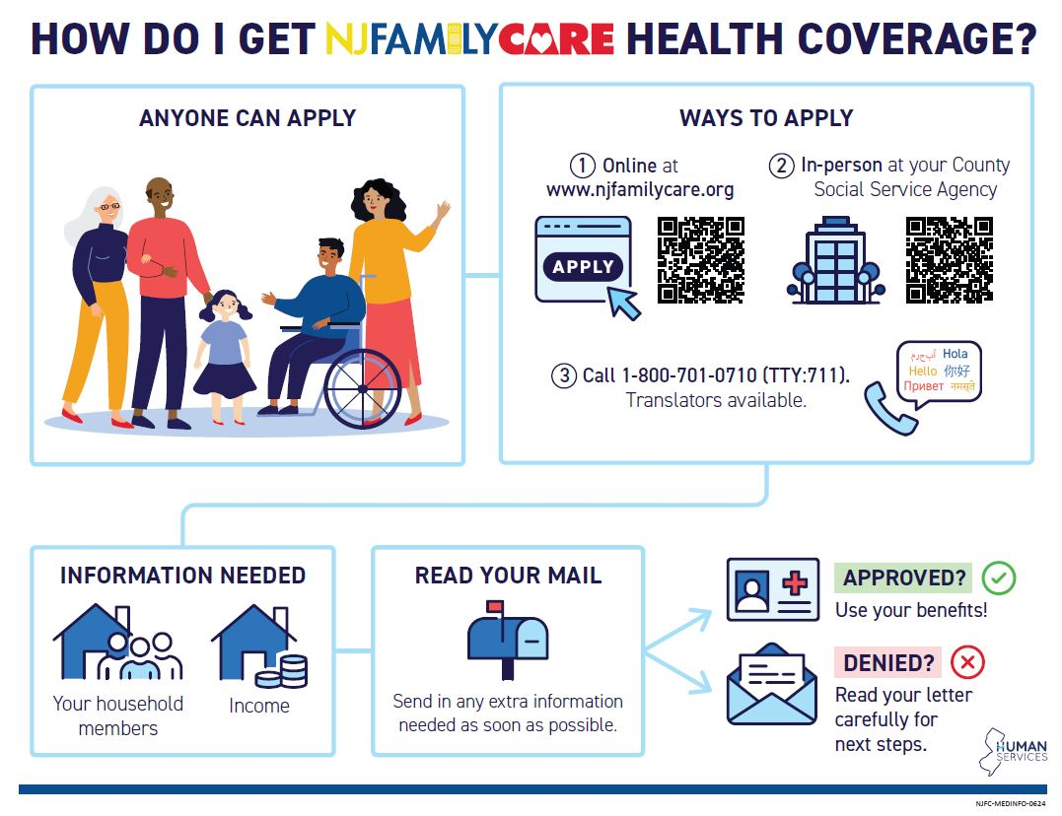
NJ FamilyCare (Medicaid)

Slide 10

NJ FamilyCare (Medicaid)

Slide 11
Health Insurance Open Enrollment

Slide 12

Open Enrollment
November 1, 2024 – January 31, 2025
This is the only time of year that you can buy or switch private health insurance plans, through an insurance broker or the Marketplace.
You are required to have health insurance. If you are uninsured for three months or longer, you have to pay a tax - unless you qualify for an exemption.

Slide 13
Special Enrollment Periods
I’m a new citizen!
I moved to a new area where my plan is not available.
I turned 26.
I had a(nother) baby!
I got out of prison.
I lost coverage but not because I didn’t pay premiums.
I am enrolled in the Marketplace, my income changed, & I’m newly (in)eligible for assistance.
I got married!
I have a yearly income below 200% FPL.

Slide 14
New Jersey’s Health Insurance Marketplace
GetCovered.NJ.gov

Slide 15

Get Covered NJ
Any US citizen or documented immigrant can buy a plan.
There are 6 companies offering plans on the Marketplace – AmeriHealth, Horizon Blue Cross Blue Shield, Oscar, Ambetter WellCare, United Healthcare, Aetna CVS Health.
Plans available through Get Covered NJ are also available through private brokers. A plan has the exact same coverage no matter where you buy it.
You are eligible for financial help if:
  You buy a plan through Get Covered NJ
  You have a qualifying income
  You are not eligible for Medicaid, CHIP, or Medicare
  You are not offered affordable, adequate job-based coverage

Slide 16
Employer Insurance
If your employer offers an insurance plan that is adequate and affordable, you are not eligible for financial assistance, regardless of whether you choose to enroll in the plan.
  Adequate - Employer coverage must provide Minimum Essential Coverage. Most plans do. Check with your employer to confirm.
  Affordable - The plan costs less than 9.02% of the total household income.

Slide 17

Projecting Income
The amount of financial help you are eligible for depends on how much income you expect to make in the year of coverage.
Income is counted for you, your spouse, and everyone you will claim as a tax dependent who is required to file their own tax return.
If your income is hard to predict, base your estimate on your past experience or recent trends. Do your best to make a realistic estimate.
If your income changes during the year, you are required to update it.

Slide 18
Choosing an Insurance Plan

Slide 19
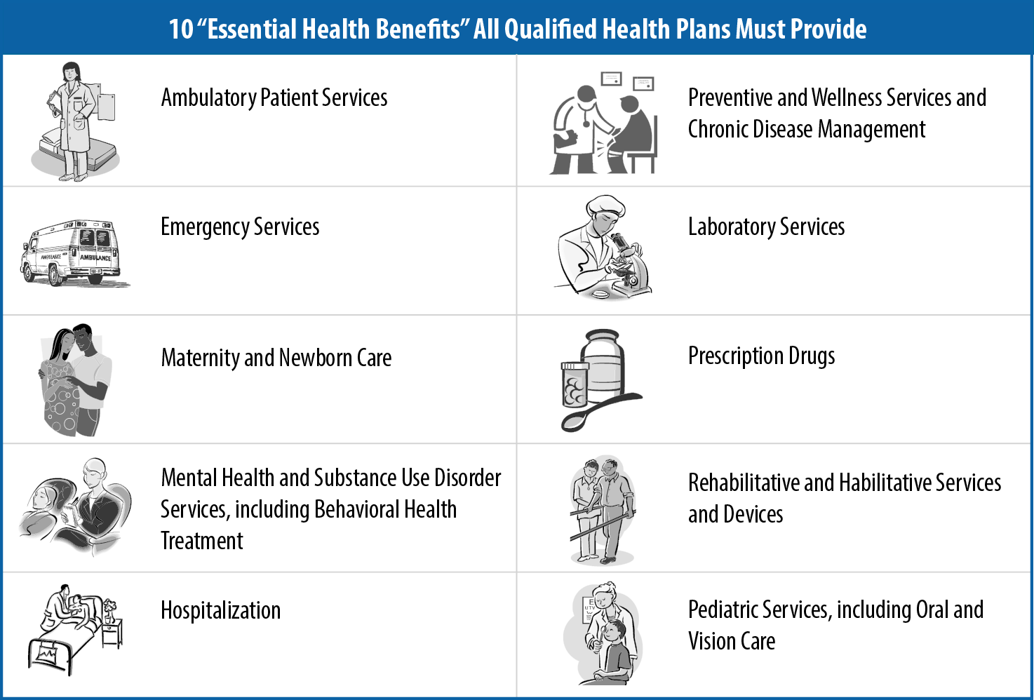
Basic Elements of an Insurance Plan
Covered Benefits
  All Get Covered NJ plans must cover ten Essential Health Benefits which are Outpatient Care, Mental Health Services, Rehabilitative Services, Lab Services, Pediatric Visits, Hospitalizations, Maternity Care, Emergency Room Care, Preventative Care, and Prescription Drugs. They have the option to cover additional benefits.
  Preventative care is free under all plans.
Provider Network
  Insurance companies contract with physicians, hospitals, and other professionals to provide services to plan enrollees.
  Each insurance company has their own unique network of providers.
  Some plans have a Tiered Network, where you pay extra to see specific providers.

Slide 20

Pre-Existing Conditions
Past illnesses, injuries or conditions
will not affect your ability to get coverage or what you pay for your monthly premium.

Slide 21

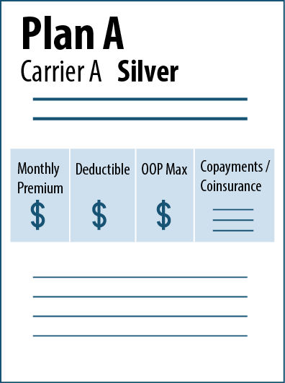
Premiums vs Cost Sharing Charges
 | Premiums
The monthly cost a person pays for a health plan
 | Cost-Sharing Charges
The charges a person pays as he or she uses benefits covered by a health plan
VS

Slide 22
Types of Cost Sharing Charges
Deductible
Enrollee must pay the deductible before the plan begins to pay for most benefits Set on a yearly basis Some services may be exempt from the deductible Some benefits may have a separate deductible (such as prescription drugs)
Copayments
Fixed dollar amount for an item or service that enrollees must pay Copayments are usually applicable before the deductible is met
Coinsurance
Percentage of the cost of an item or service that enrollees must pay

Slide 23
Maximum Out-of-Pocket Limit (OOP)
Puts a cap on what the enrollee pays in cost-sharing charges
Set on a yearly basis
Includes money paid towards cost sharing charges (deductible, copayments and coinsurance ), but not premiums.
OOP limit is not the amount that an enrollee must spend each year.
Maximum OOP Limit for 2025 Coverage
Individual OOP Limit (NOTE: applies to each individual in a family plan as well) | $9,200
Family OOP Limit | $18,400

Slide 24
Cost Sharing Example
Health Plan X:
Deductible | $5,500 | Primary care visit | $40
OOP limit | $6,350 | Specialist visit | 25%
Inpatient hospital | 25% | Generic drug | 25%
John pays 100%
Reach $5,500 deductible
John pays 25% coinsurance
Reach $6,350 OOP limit
Plan pays 100%
Health Costs: $6,300
Health Costs: $5,500
John OOP cost: $5,500
+ $40 copay
John OOP cost: $200
(25% of $800)
John OOP cost:
$570
(25% of $2,280)
+ $40 copay
John OOP cost:
$0
JAN FEB MAR APR MAY JUN JUL AUG SEPT OCT NOV DEC

Slide 25



Get Covered NJ Plans
Plans on Get Covered NJ are divided into 3 categories: Bronze, Silver and Gold.
Categories are based on how you and your plan split the costs of your health care. They have nothing to do with quality of care.
Costs covered by a plan
METAL LEVEL PLAN TIERS
Gold | This plan has a high monthly premium and low cost when you need care. It is a good choice if you are willing to pay more each month to have more costs covered when you get medical treatment.
Silver | This plan has a moderate monthly premium and moderate cost when you need care. It is a good choice if you qualify for extra help, or if you are willing to pay a higher monthly premium than Bronze and have more of your routine care covered.
Bronze | This plan has the lowest monthly premium and high cost when you need care. It is a good choice as a low-cost way to protect yourself from worst-case medical scenarios. You will pay for most routine care yourself.
Catastrophic | High deductible health plan available for individuals up to age 30.
Premiums paid by consumer

Slide 26
GET COVERED NJ - Financial Help
Anyone can purchase a plan on Get Covered NJ. Only some people qualify for financial help.
There are 3 types of financial help available through the Marketplace:
  Premium Tax Credits (PTC) - Help paying your monthly premiums.
  Cost Sharing Reductions (CSR) - A reduction in the out-of-pocket charges you pay for medical care covered by the plan. This is only available if you enroll in a plan on the Silver Level.
  New Jersey Health Plan Savings (NJHPS) - Additional help paying for your monthly premiums.
If you receive financial help, you must file taxes at the end of the year and cannot be a dependent on someone else’s tax return. If you are married, you must file taxes jointly.
Premium Tax Credits are reconciled on your tax return. Cost Sharing Reductions and NJHPS are not reconciled.

Slide 27

GET COVERED NJ – Financial help
You can see what financial help will be offered to you by going to www.GetCovered.NJ.gov and clicking on COMPARE PLANS.

Slide 28

Cost Sharing reduction (CSR) example
CSR Level | No CSR | 201–250% FPL | 151–200% FPL | <150% FPL
Deductible | $4,500 | $3,000 | $750 | $250
OOP limit | $6,300 | $5,200 | $2,250 | $2,250
Inpatient hospital | No charge (after ded.) | No charge (after ded.) | No charge (after ded.) | No charge (after ded.)
Primary care visit | $10 | $8 | $5 | $3
Specialist visit | $20 | $18 | $10 | $5
Generic drugs | $5 (after ded.) | $4 (after ded.) | $3 (after ded.) | $2 (after ded.)
Specialty drugs | $285 (after ded.) | $250 (after ded.) | $150 (after ded.) | $150 (after ded.)

Slide 29
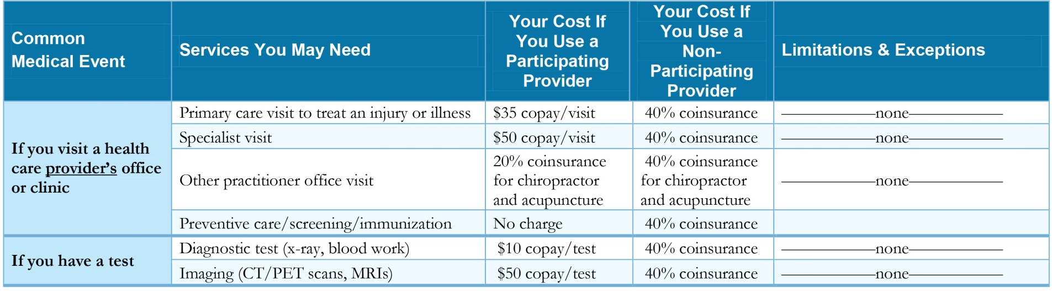
Choosing a plan
Once you understand key terms, you can compare plans.
Consider each plans:
  Provider network
  Monthly premium
  Cost for covered services & other included services
  Prescription drug formulary
Each plan has a Summary of Benefits which lists the costs for each service in clear and simple terms.

Slide 30



Next steps
If you think you may be eligible for NJ FamilyCare, apply online at njfamilycare.org.
If you are not eligible for NJ FamilyCare but are offered affordable insurance through an employer, you will not be eligible for financial help purchasing a private plan. You can view full price plans at GetCovered.NJ.gov and sign up through an insurance broker.
If you are not eligible for NJ FamilyCare and are not offered affordable insurance through an employer, you may be eligible for financial help through Get Covered NJ. To apply, go to GetCovered.NJ.gov.
The LRRC provides free assistance completing the application and comparing plans.

